Slide 1
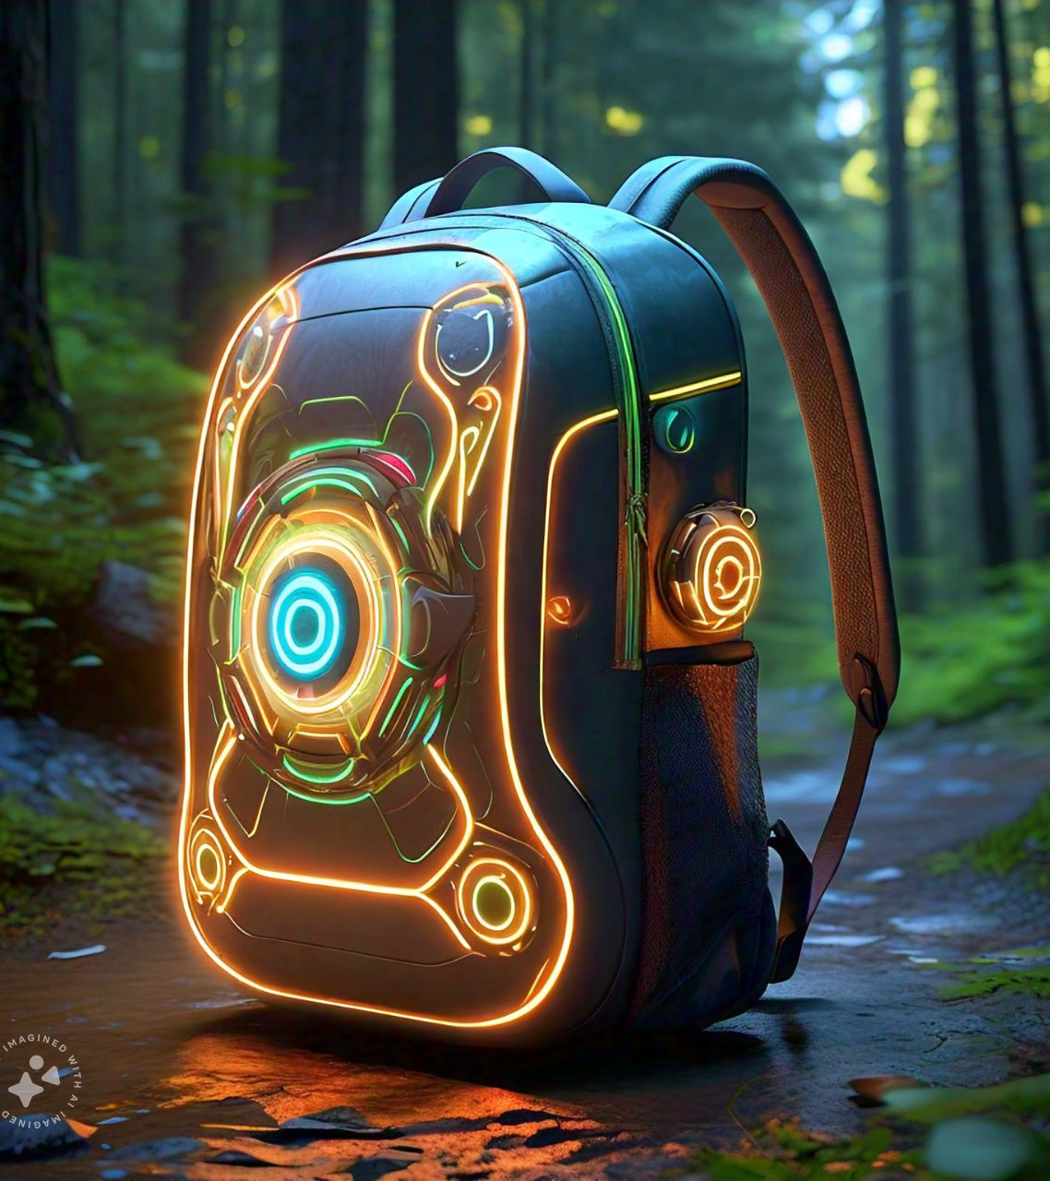
HUMAN POWERED GENERATOR BACKPACK
TEAM MEMBERS
1. K. Harsha vardhan
2. K.Sai siva ram
3. K.Manideepak
4. K.Gopinath

Slide 2
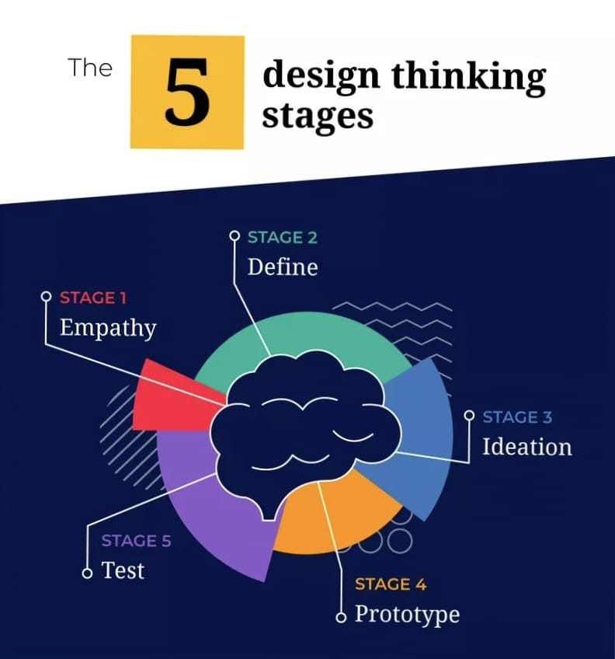
CONTENTS
Introduction
Problem Definition
Explanation
Key features
Phases:
Empathize
Define problem
Ideate problem
Prototype
Test phase

Slide 3
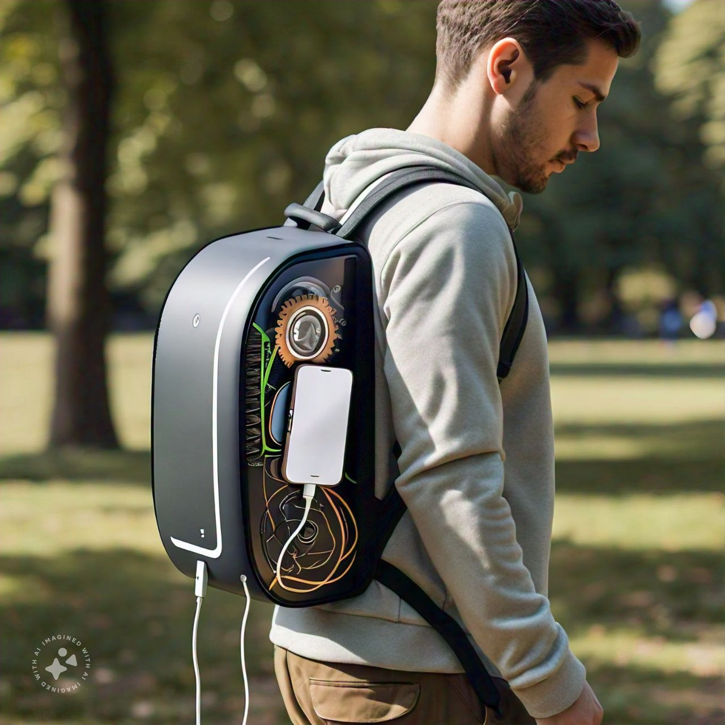
INTRODUCTION
Energy is existing everywhere and always being transferred from one state to another, even with the slightest movement of an object or matter.
As travelers increasingly rely on electronic devices like smartphones, GPS units, cameras, and portable lights for navigation, communication, and safety, keeping these devices charged during long journeys becomes a significant concern.

Slide 4
Problem Definition
Design a human-powered generator backpack that efficiently converts kinetic energy from the user's movements into electrical energy to power portable devices, aiming to provide a sustainable and off-grid energy solution for outdoor enthusiasts, emergency responders, and individuals in remote areas.

Slide 5
Explanation
The “Human-Powered Generator Backpack” is an innovative wearable device designed to harness kinetic energy generated by human movement and convert it into electrical energy.
This portable, self-sustaining power source is ideal for individuals who require reliable energy in remote or off-grid locations, such as outdoor adventurers, emergency responders, and people in disaster-prone areas.

Slide 6
OVER VIEW AND PURPOSE:
The primary purpose of the Human-Powered Generator Backpack is to generate electrical power from the energy produced by a user’s movements, such as walking, running, or cycling.
Charge devices like smartphones, GPS units, lights, communication equipment, or other small electronics.

Slide 7
CORE MECHANISM
The core functionality of the backpack relies on the principle of “kinetic energy harvesting”. As the user moves, mechanical energy is captured through various mechanisms integrated into the backpack, such as:
Piezoelectric materials
Dynamos or small generators
Energy storage system

Slide 8
DESIGN CONSIDERATIONS
The design of the Human-Powered Generator Backpack is tailored to meet several key requirements:
Comfort
Weight and size
Energy output
Durability and protection
Sustainability

Slide 9
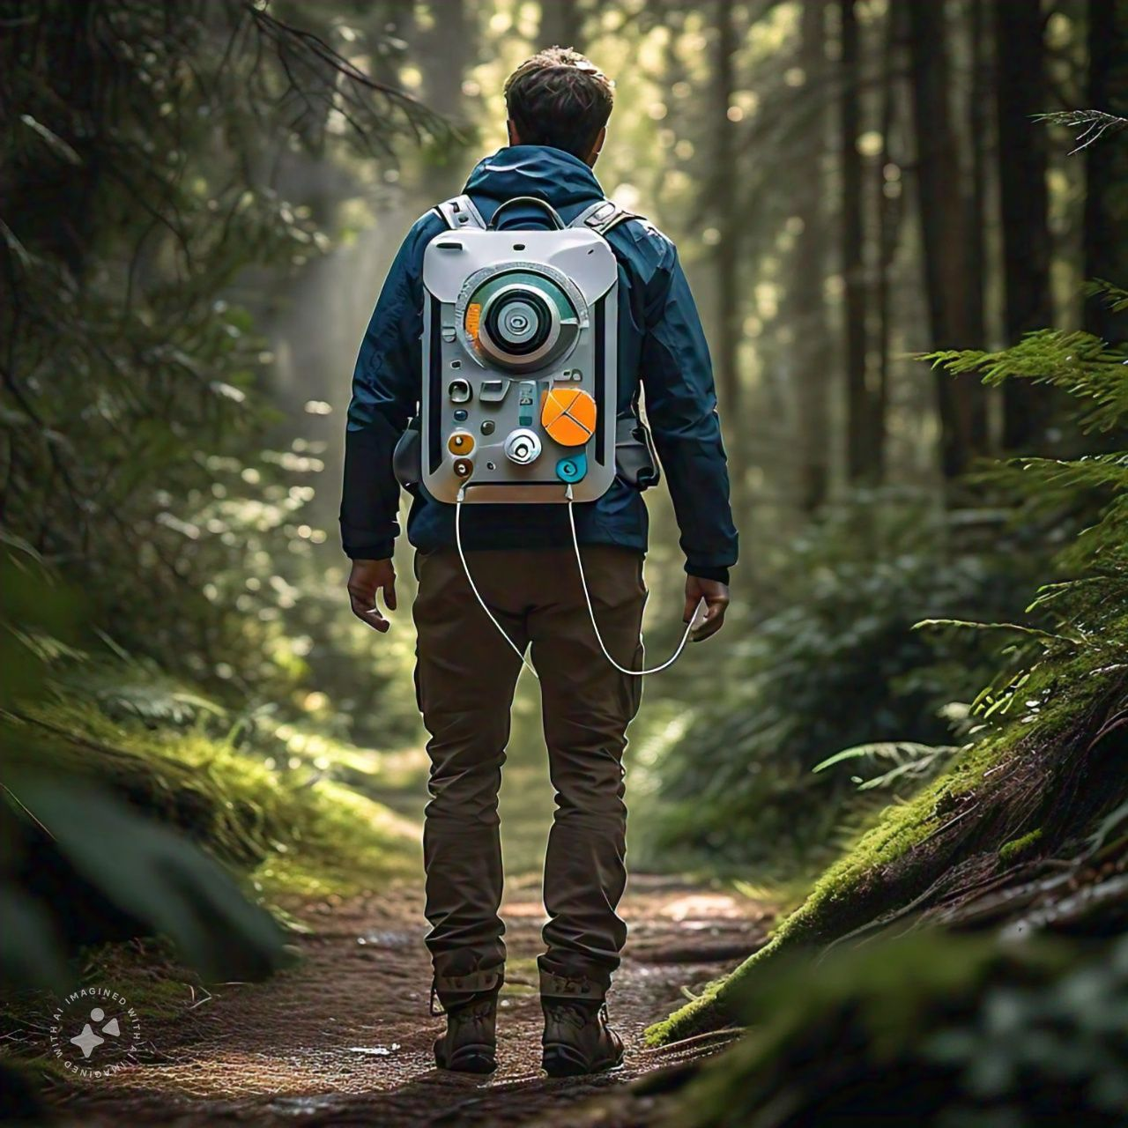
KEY FEATURES
Energy Storage
Generator Mechanism
Portability
Eco-Friendly
Applications

Slide 10
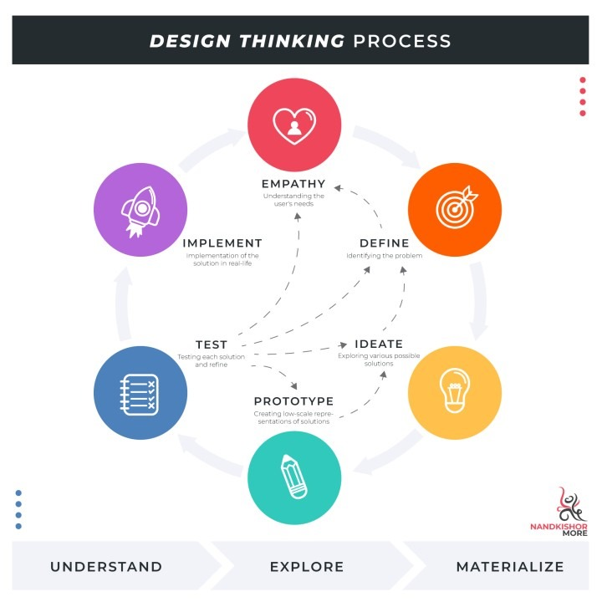
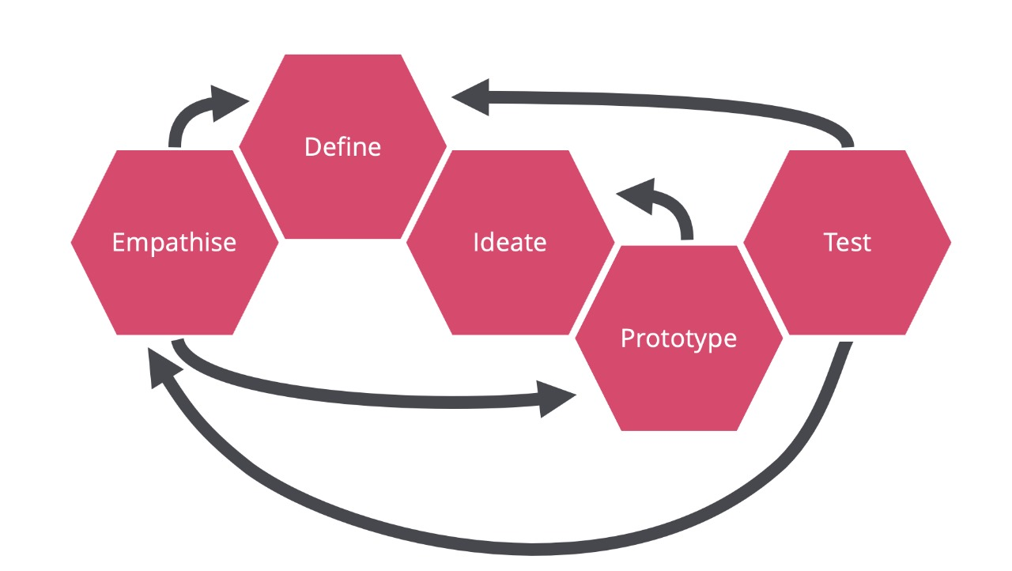
PHASES

Slide 11

EMPATHISE:

Slide 12

USERS:
Outdoor Enthusiasts
Students
Emergency Responders
Military Personnel
Travelers
Fitness and Sports Enthusiast
Urban Professionals

Slide 13
NEEDS:
Portable and Lightweight Design
Efficient Power Generation
Ease of Use
Durability and Weather ResistancePower Storage Capability

Slide 14
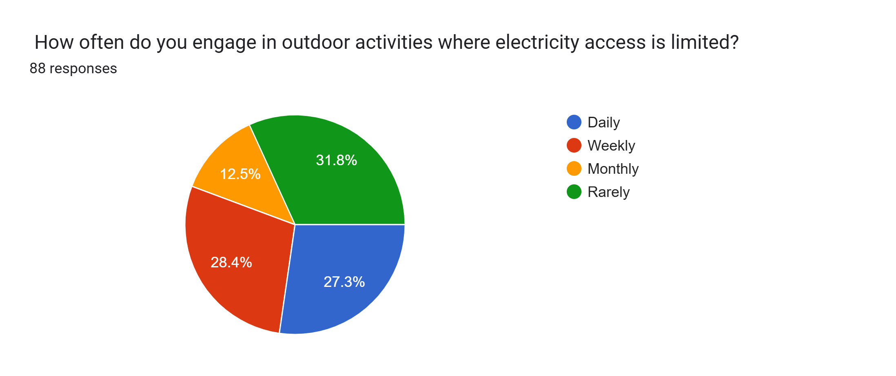
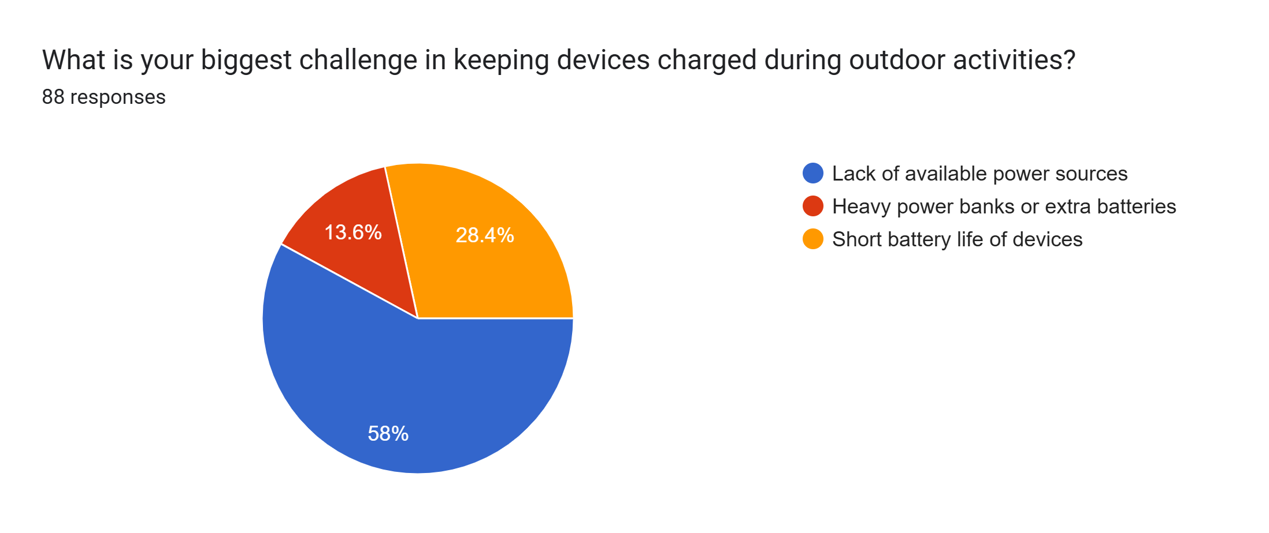
PRIMARY
SURVEY
RESULTS

Slide 15
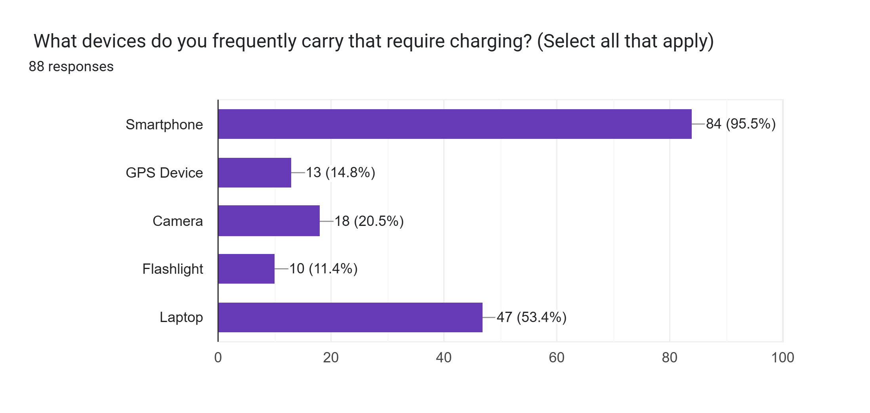
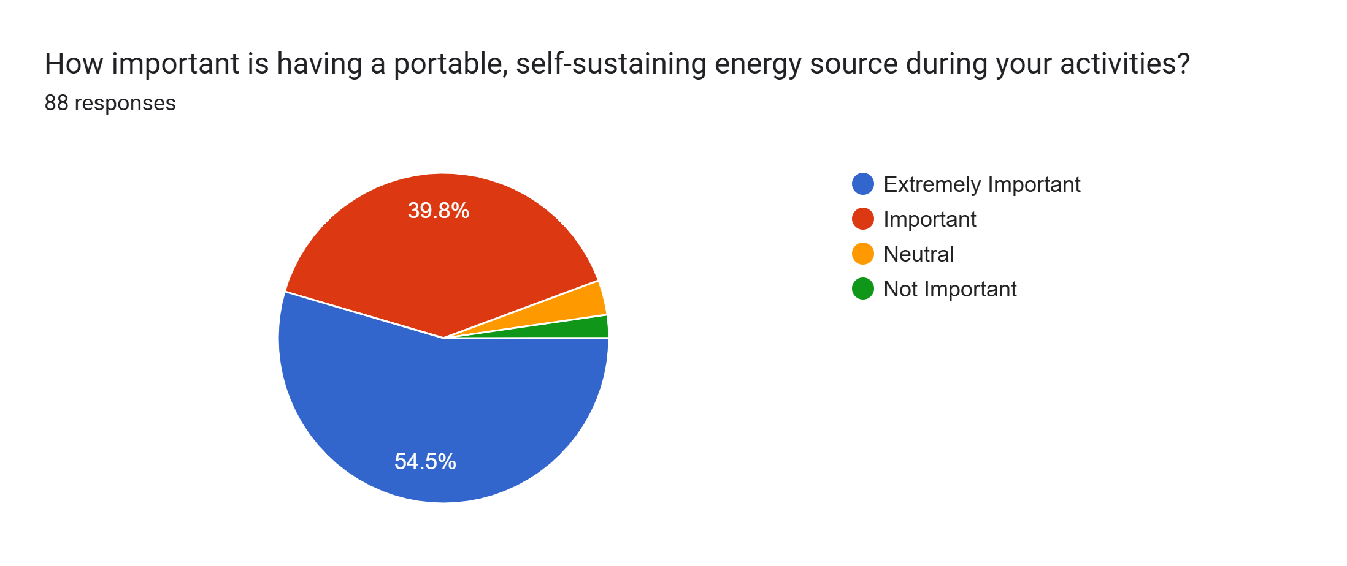
PRIMARY
SURVEY
RESULTS

Slide 16
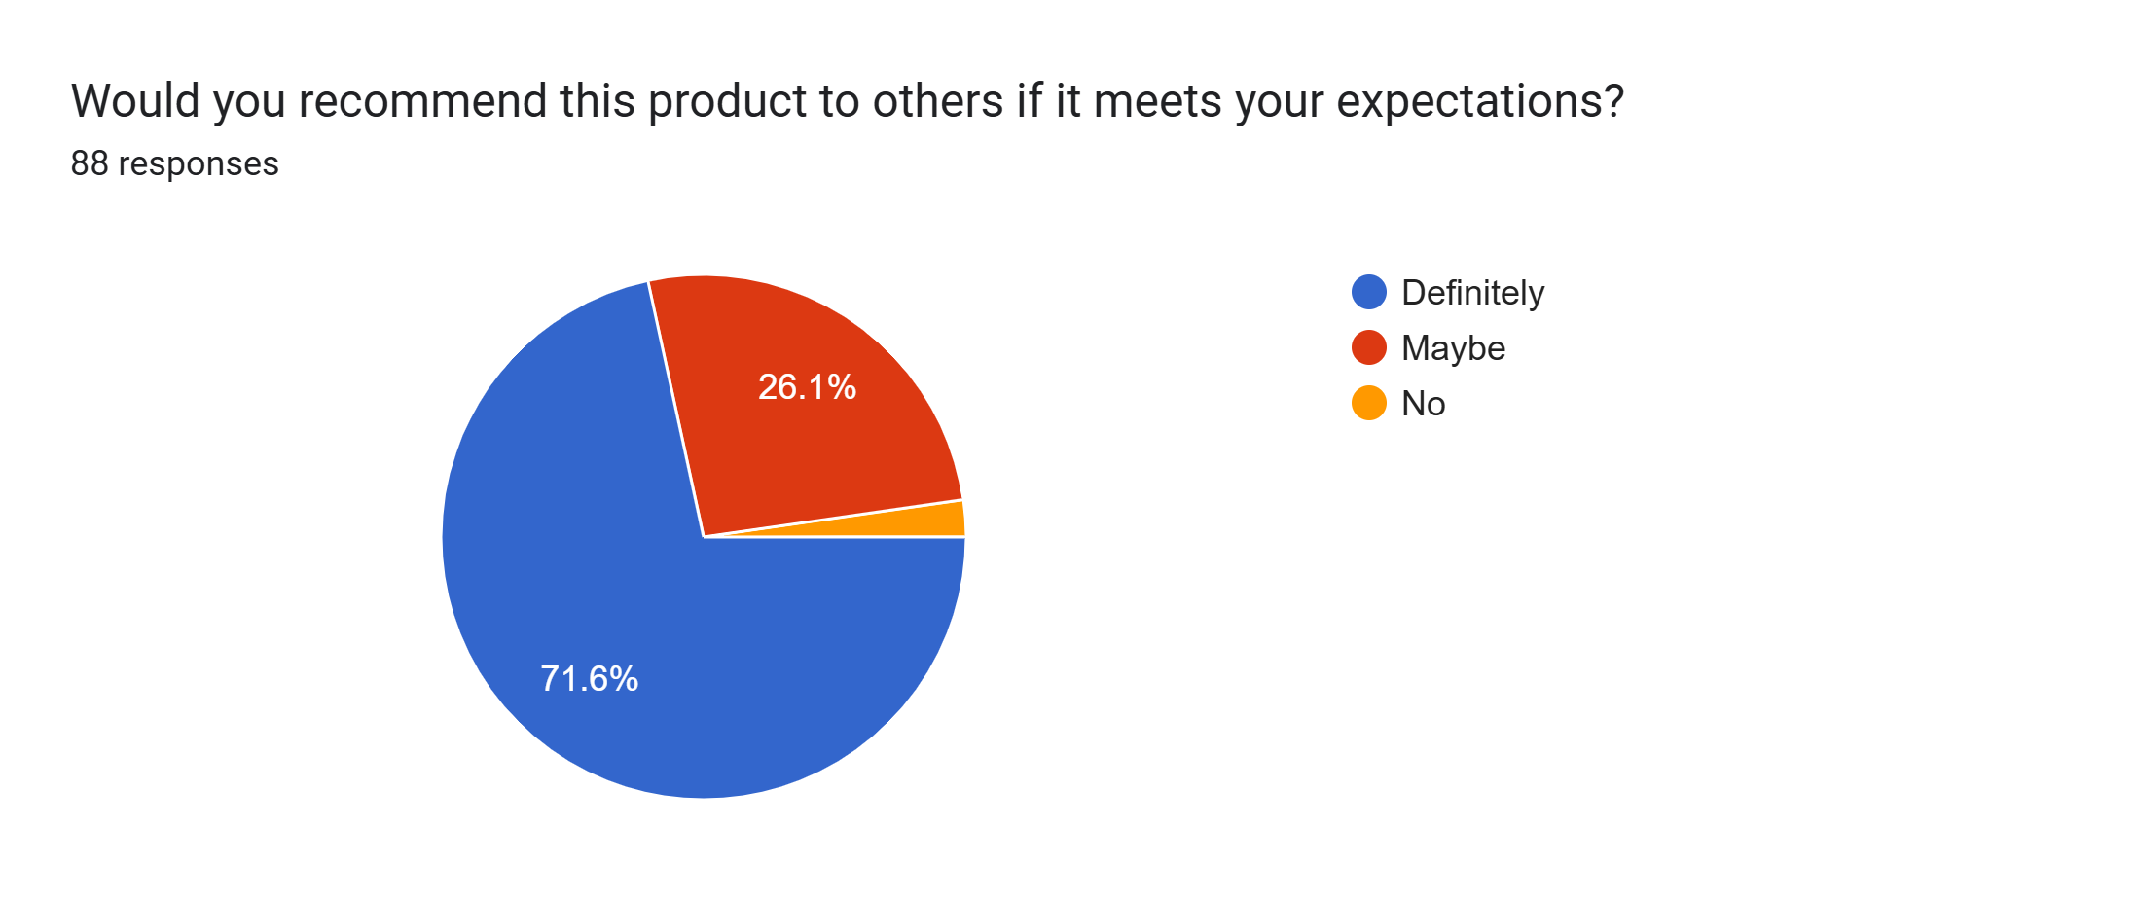
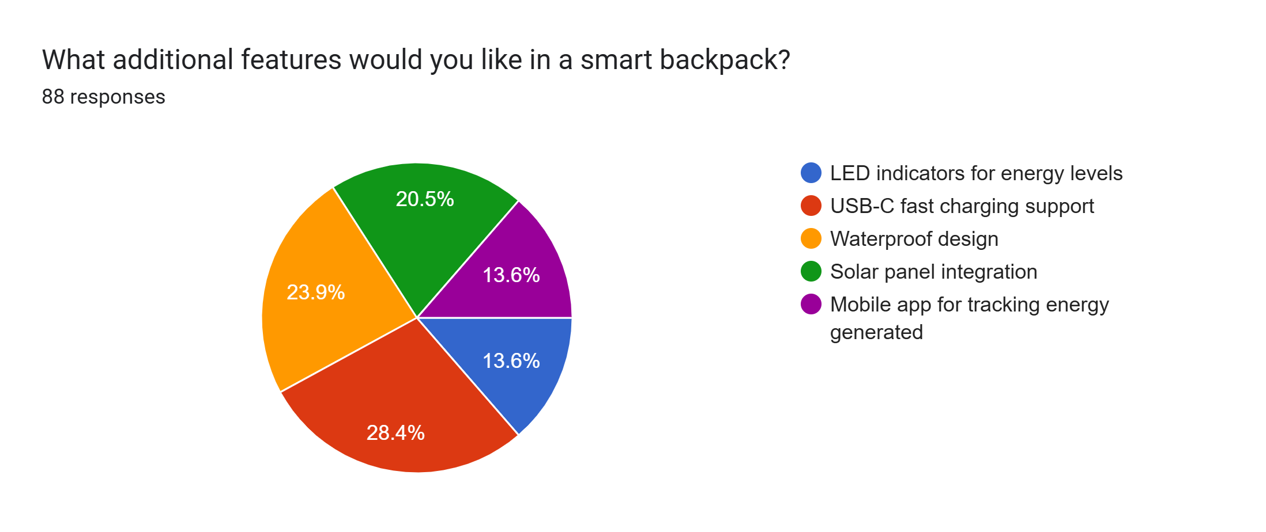
PRIMARY
SURVEY
RESULTS

Slide 17
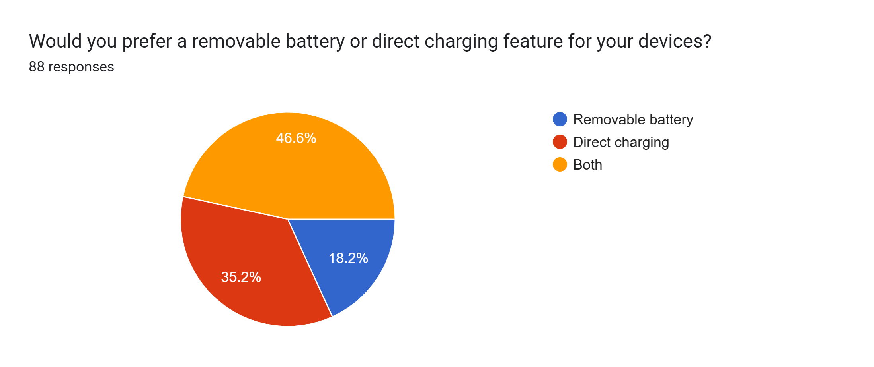
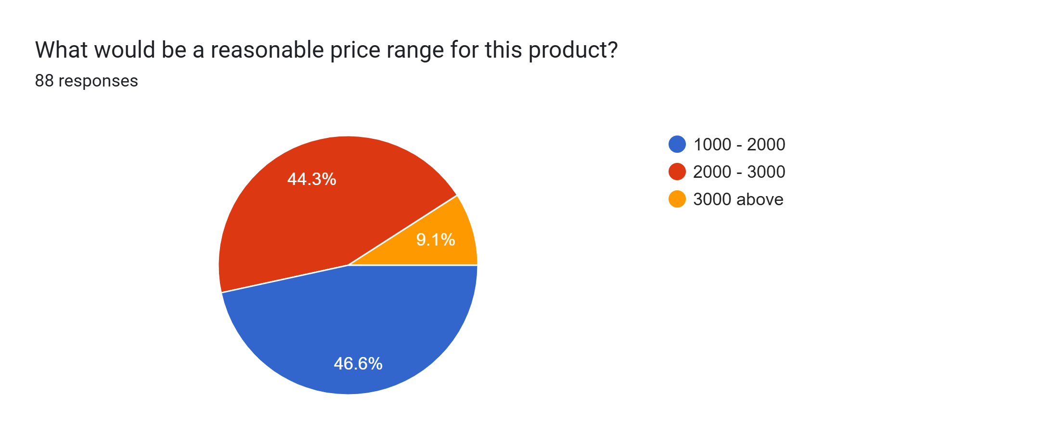
PRIMARY
SURVEY
RESULTS

Slide 18
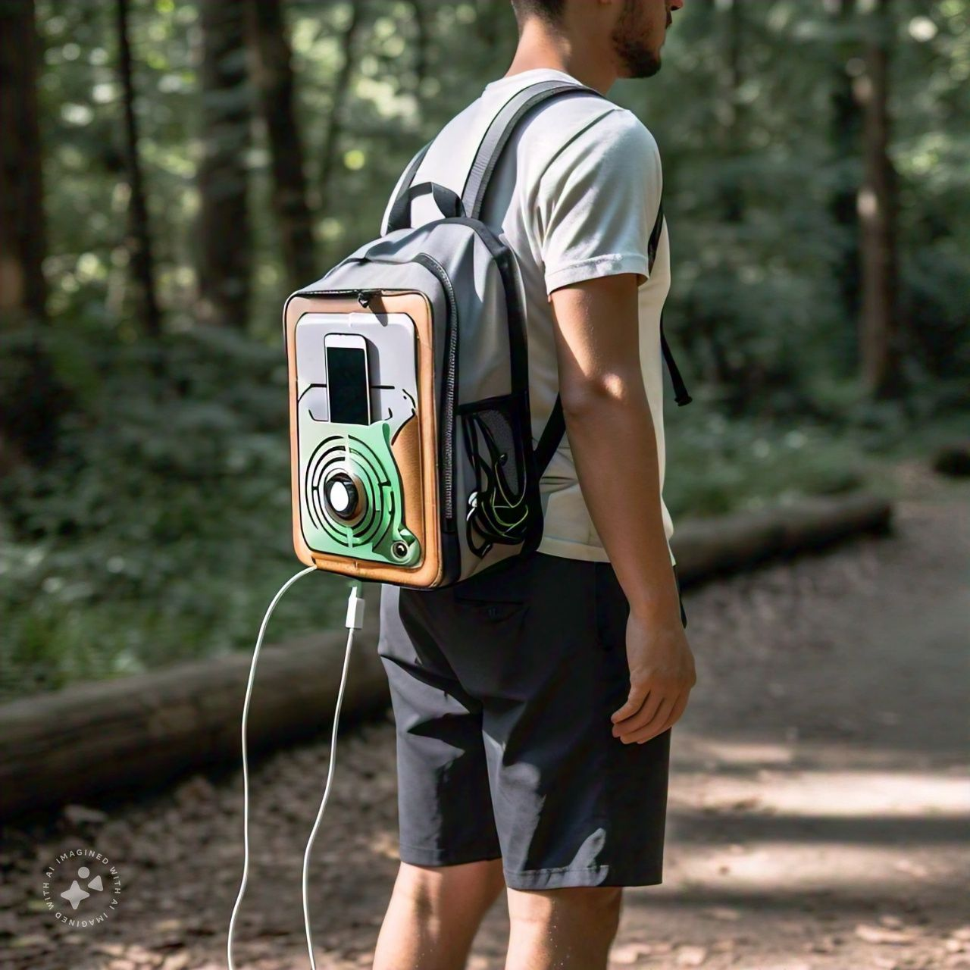
2.DEFINE PROBLEM
Create a backpack that turns the energy from a person's movement into electricity. This electricity can be used to charge devices like phones or lights, making it a reliable power source for outdoor activities, emergencies, or places without access to regular power.

Slide 19
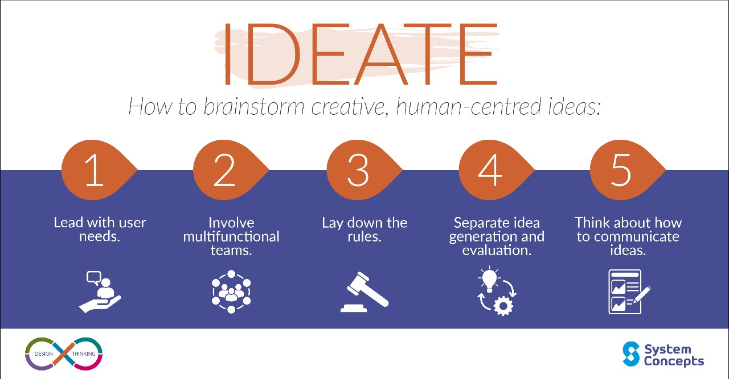
3.IDEATE PROBLEM

Slide 20
1)Questions araised:
How might we generate more power with minimal components?
How might we ensure the backpack is lightweight and highly efficient?
How might we simplify the energy generation mechanism while enhancing user benefits?
2) Solutions:
High-Efficiency Energy Generation
Optimized Output with Fewer Sensors
Lightweight and Durable Design

Slide 21
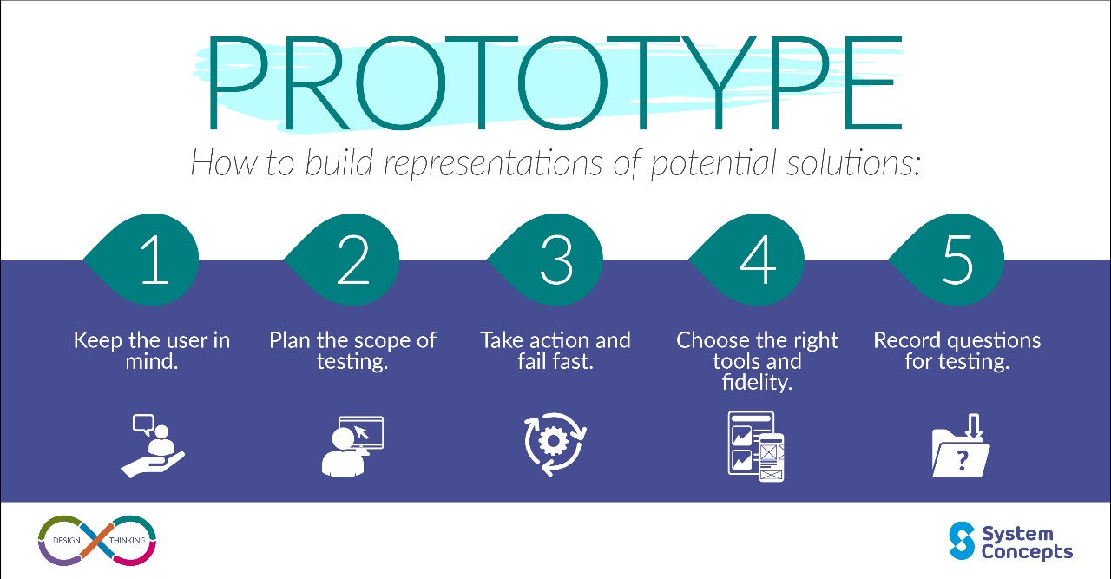
4.PROTOTYPE

Slide 22
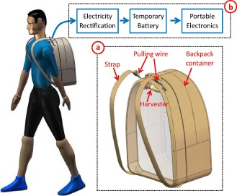
Conceptual Design and Initial Prototyping:
A. Sketches and 3D Models:
Objective : Create initial visual concepts to explore the design of the backpack.
B. Material Selection:
Objective: Choose materials that balance durability, weight, and sustainability.
Backpack Exterior
Power Generation Mechanism
Battery Compartment
Power Output Ports

Slide 23
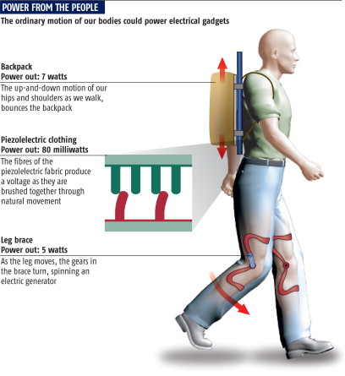
2. Prototyping:
Initial Functional Prototype:
Objective: Build a working prototype that integrates the power generation system.
B. Testing of Basic Functions:
Objective: Evaluate the efficiency and usability of the first prototype.
Power Generation Test
Comfort
Durability Test

Slide 24
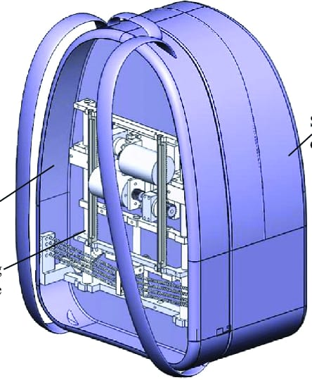
4. Refinement and Iteration:
Design Refinement:
Objective: Improve the backpack design based on user feedback and test results.
Comfort Improvements
Power Generation System
B. Prototype 2.0:
Objective: Develop an updated prototype that integrates refinements and additional features.
Energy Harvesting Efficiency
Power Management System
Accessibility Features

Slide 25
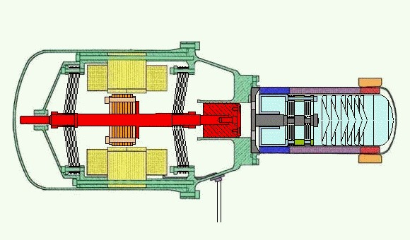

COMPONENTS USED
Linear Alternator
Gear and pulleys

Slide 26
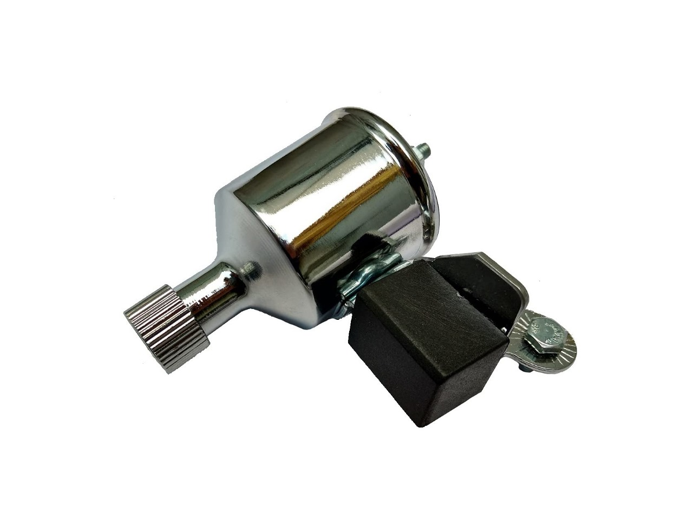
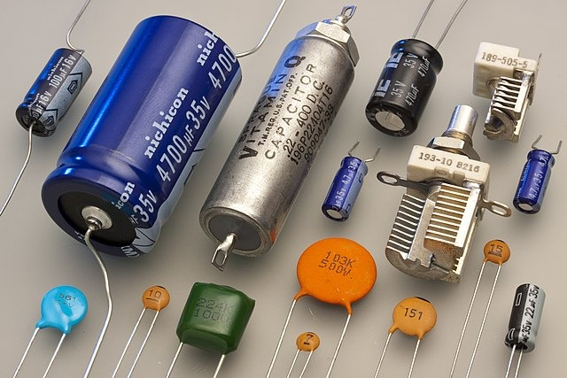
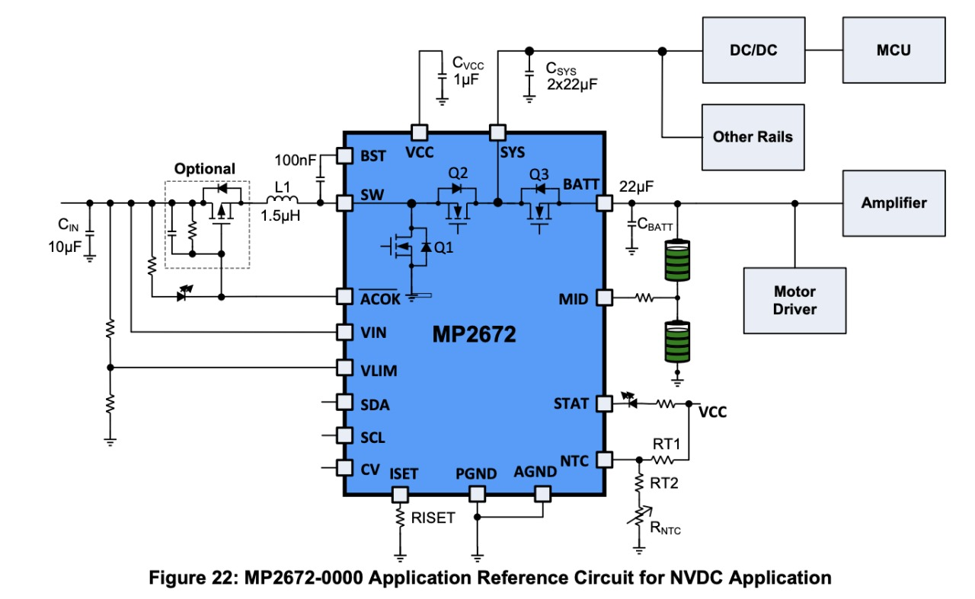
Dynamo Generator
Capacitor
Power Management Circuit

Slide 27
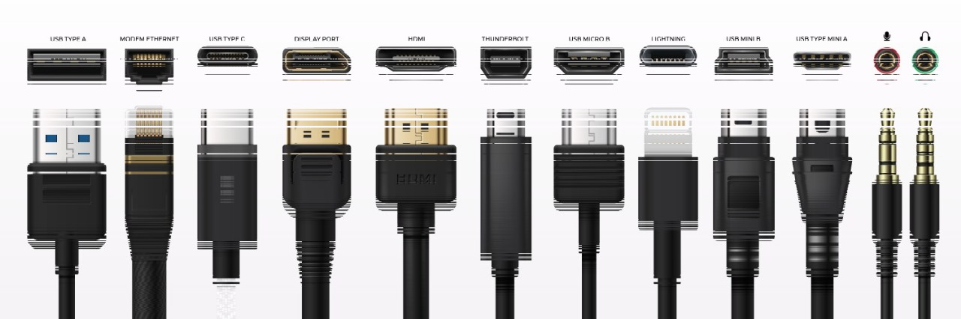
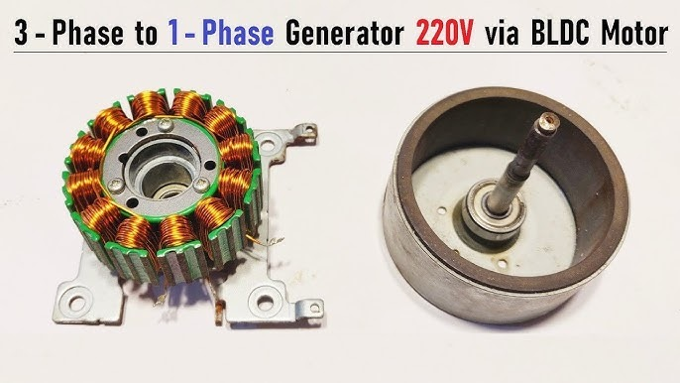
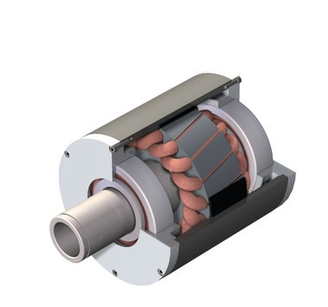
Charging ports or connectors
Brushless DC generator
Permanent magnet generator

Slide 28
THEORITICAL WORK
The time it takes for a person to walk 7,000 steps depends on their walking speed and the person’s step length. Here’s a general breakdown:
1.Average Walking Speeds
Normal walking pace: 5 km/h (3 mph)
Brisk walking pace: 6–7 km/h (3.7–4.3 mph)
2. Step Length and Distance Covered
Average step length: 0.7–0.8 meters (2.3–2.6 feet) per step.
- At 0.75 meters per step, 7,000 steps = 5.25 km (3.27 miles).
3.Time Calculation
At a normal pace (5 km/h):
At a brisk pace (6.5 km/h):
Estimated Time
-Normal pace: ~60–70 minutes
-Brisk pace: ~45–50 minutes

Slide 29
Energy for 1% Charge:
Converting Watt-hours to Joules (since 1 Wh = 3,600 Joules): 0.148 Wh×3,600=532.8 J
Therefore, about 533 Joules are needed to charge 1% of a typical 4,000 mAh smartphone battery.
Factors to Consider:
1.Charging Efficiency: Charging isn't 100% efficient due to heat and power losses.
Typical efficiency rates range from 80% to 90%.
Assuming an 85% efficiency, the energy required would increase by about 15%.
Adjusting for efficiency: Adjusted Energy=533 J/0.85≈627 Joules
2.Battery Sizes: The calculation changes if the battery is larger or smaller.
For example:
▪ A 5,000 mAh battery at 3.7V would need around 740 Joules (adjusted for efficiency) per 1% charge.
▪ A 3,000 mAh battery at 3.7V would need around 445 Joules (adjusted for efficiency) per 1% charge.
For a typical 4,000 mAh smartphone battery, charging 1% requires about 627 Joules of electrical energy when accounting for efficiency losses.

Slide 30
Calculating Energy per Minute:
- Let's take the average of 100 steps per minute and the average kinetic energy per step of ~68.6 Joules.
Total kinetic energy per minute:
68.6 joules/step x 100 steps/minute = 6860 joules/minute
Kinetic Energy per Step: About 68.6 Joules for an average adult walking at 1.4 m/s.
Steps per Minute: 60-140, with an average of about 100 for normal walking.
Kinetic Energy per Minute: Approximately 6,860 Joules per minute for moderate walking.

Slide 31
SOFTWARE INTERFACE
We can add a software interface to this prototype
In this interface it shows how much distance the user travelled and by that how much electricity is generated.
The interface also contains daily goals which encourages and promotes walking.
By checking how much electricity is generated it shoe what type of devices can be charged and for how much time it can be charged and how much electricity is left in that device and so on….
This promotes the user to use this product frequently.

Slide 32


